Slide 1





John Robert Lewis Early Childhood Center
It All Starts Here!
123 Cleveland Street
(973) 677-4000 ext. 51700
New Parent/Family Orientation
August 29, 2025
1:00-2:00 p.m.
Dr. Cayce J. Cummins, Principal

Slide 2

Welcome
Parents and Families!
First Day of School Checklist
Complete Emergency Contact(s)/Pick Up Form (Children cannot be dropped off at the school if we do not have this form.)
Include your email address(es) on the Emergency Form.
Change of clothes
Crib sheet, blanket, and pillow for rest time
Pull-ups and wipes for potty training if needed
Full School Supply List is on our Website

Slide 3


District Mission Statement
We believe in the power of unity, purpose, and collective growth. We value every student and staff member, honor every voice, and embrace every opportunity to grow, lead, and inspire. Rooted in community and committed to excellence, we rise together driven by shared purpose and dedicated to achieving optimal success for all.

Slide 4


The school and classroom doors open at 8:30 a.m. Children and parents are not allowed inside
before that time.
Parents or drop-off person must sign their child in on the sign-in sheet located outside of the classroom.
Dismissal is at 3:00 p.m.
All students must be signed out by the authorized adult for pick up. Anyone picking up a child must be at least 12 years old and listed on the Emergency Form.
Any adult NOT on the approved list without a photo ID will not be able to pick up the student.
If there are any changes in phone number(s) address and/or Emergency Contacts, please update this form immediately with Ms. Quiles in the Main Office

Slide 5

When school starts, only school and district staff are allowed to enter or park in the parking lot.

Slide 6

A flu shot for all students under the age of 5 is mandatory as per state law. December is the deadline for the flu shot. After this time, students who have not had the shot may be excluded from school beginning in January.

Slide 7

Any medical issues: Asthma, Allergies, Seizures, etc. MUST have an Action Plan submitted by the doctor to the school nurse.

Slide 8

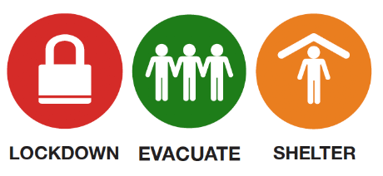
Monthly Emergency Drills
One Fire Drill per month
One Emergency Drill per month

Slide 9
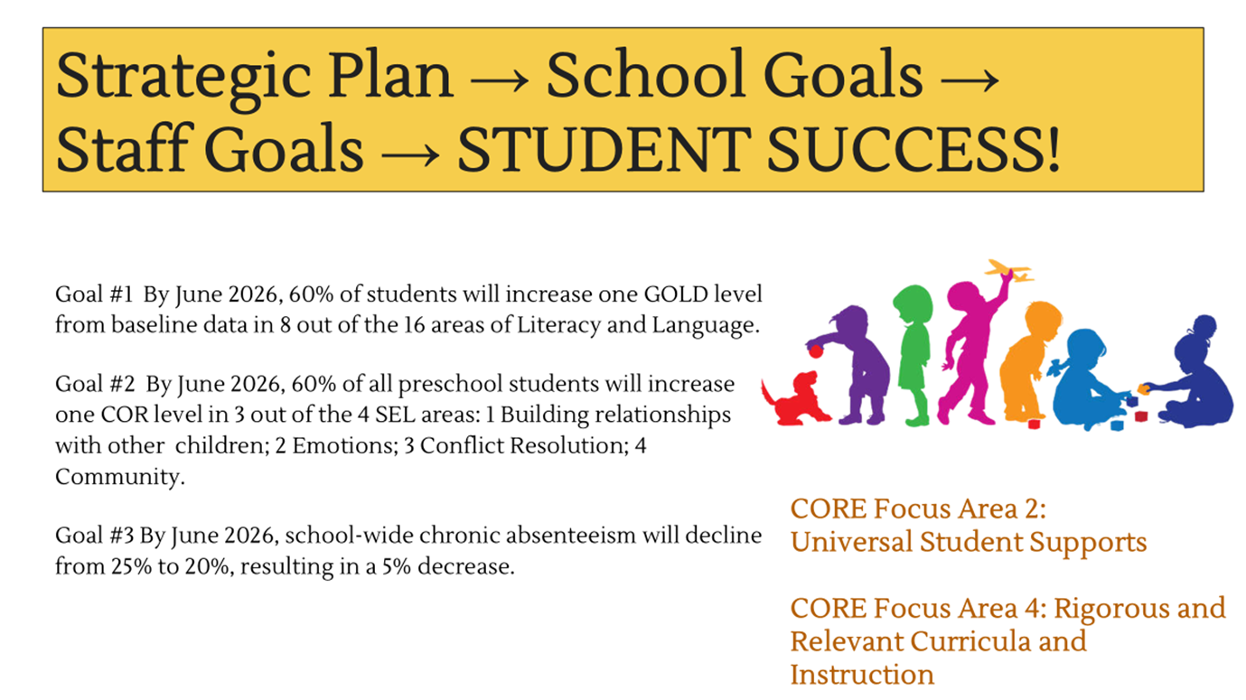

Slide 10
Creative Curriculum
Implemented this curriculum beginning last year
On Back to School Night, September 29th from 6:00-800 p.m., we will discuss more information and the successes we’ve experienced with our new curriculum.
Parent/Family Engagement
End of Unit Celebrations
Newsletters for Parents/Families
Frequently Asked Questions (FAQs) and Answers on our school website

Slide 11
Creative Curriculum
Implemented this curriculum beginning last year
On Back to School Night, September 29th from 6:00-800 p.m., we will discuss more information and the successes we’ve experienced with our new curriculum.
Parent/Family Engagement
End of Unit Celebrations
Newsletters for Parents/Families
Frequently Asked Questions (FAQs) and Answers on our school website

Slide 12
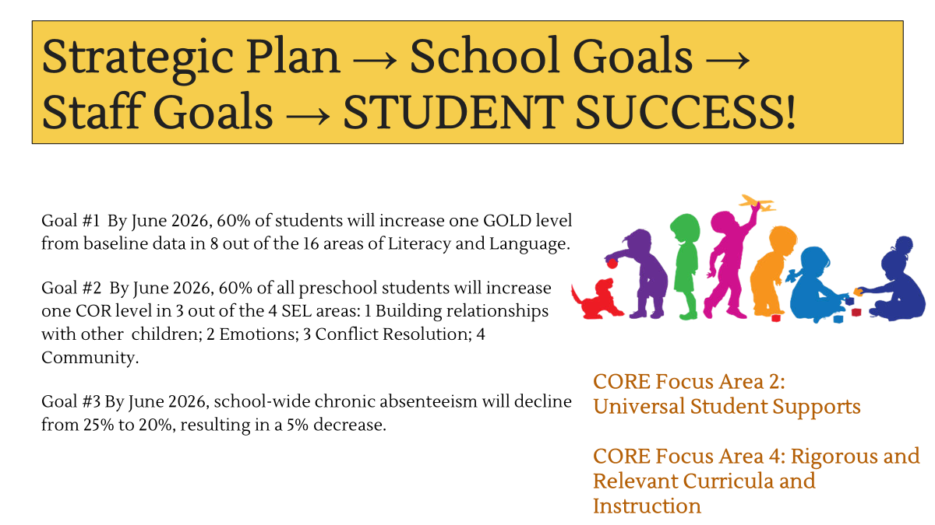
Teaching Strategies Mobile App

Slide 13
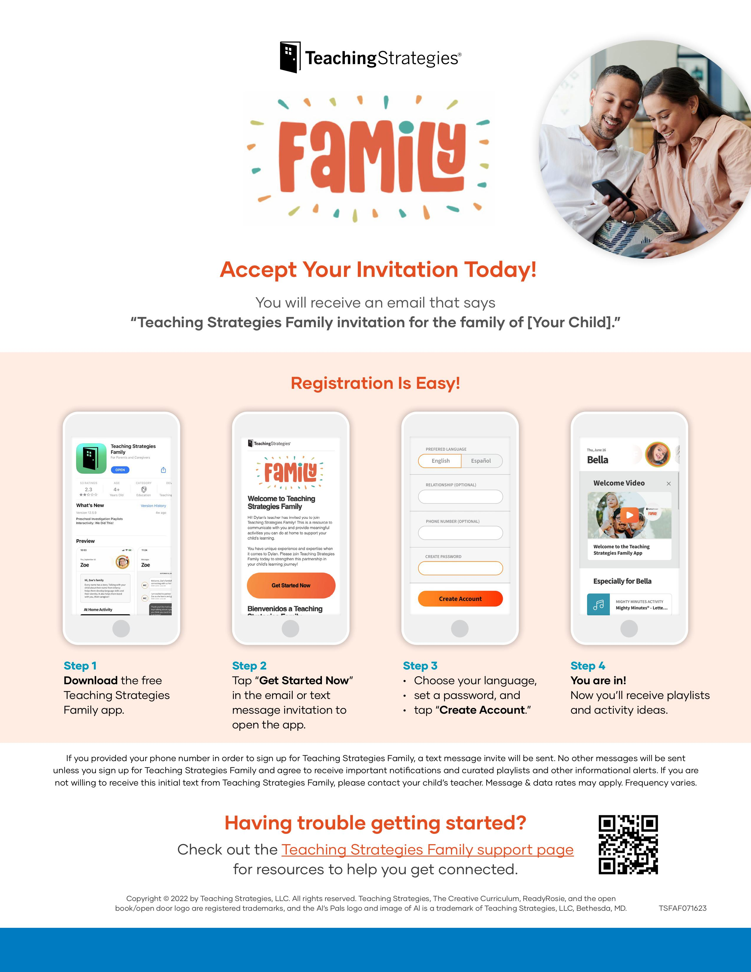
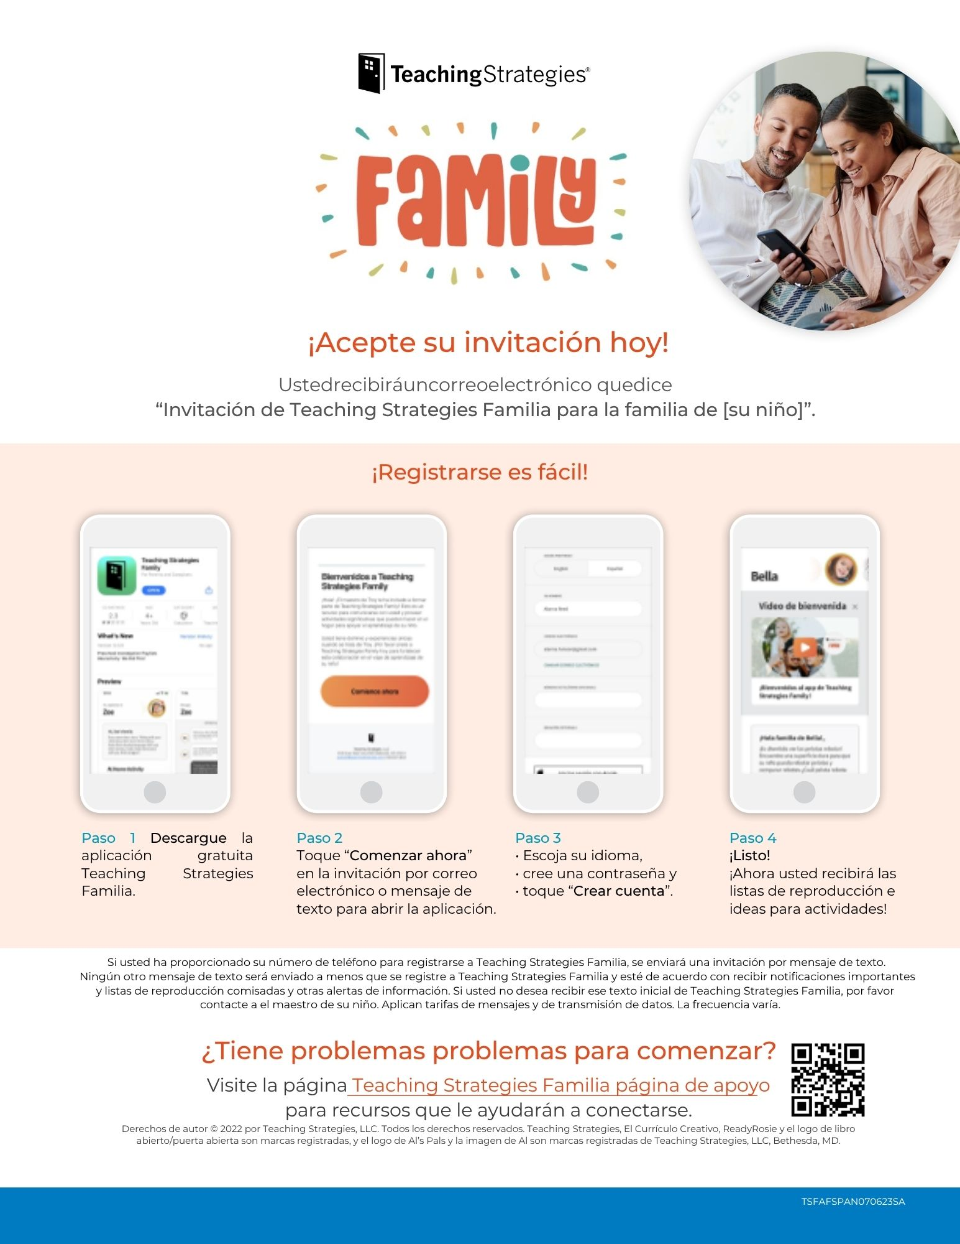
Teaching Strategies Mobile App - Continued

Slide 14
2025-2026 Units of Study
First Six Weeks
Trees
Clothes
Buildings
Reduce, Reuse, Recycle
Balls
Wheels

Slide 15
The Preschool Creative Curriculum Schedule
Time | Teacher/Para
8:30 - 8:50 | Arrival/ Breakfast
8:50 - 9:10 | Large Group
9:10 - 9:30 | Small Group
9:30 - 9:45 | Music & Movement
9:45 - 10:00 | Read Aloud
10:00 - 10:05 | Transition
10:05 - 10:50 | Outdoor Choice
10:50 - 10:55 | Transition
10:55 - 11:00 | Planning
11:00 - 12:00 | Choice Time Para break 11:00 - 11:15 Teacher Prep 11:20 - 12:05
12:00 - 12:05 | Cleanup
12:05 - 12:35 | Lunch
12:35 - 1:35 | Rest & QA Para Lunch: 12:35 Teacher Lunch: 1:05
1:35 - 1:55 | Bathroom
1:55 - 2:10 | Read Aloud
2:10 - 2:20 | Roundup
2:20 - 3:00 | Limited Choice/Snack Para break 2:30 - 2:45

Slide 16
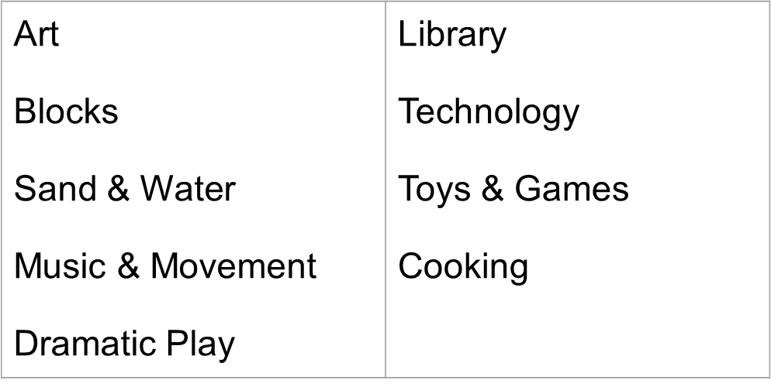
Interest Areas in the Classroom

Slide 17

Daily Outdoor Time
Make sure that your child is dressed appropriately for the weather.

Slide 18


Family Style Eating- Breakfast and Lunch are eaten in the classroom as a class.
Menus are posted monthly

Slide 19
Children’s Birthday Acknowledgements
We honor children and we acknowledge them on their special day.
How can we honor each child?
Have them walk around a premade sun based on their age
Give the child a special job, let him/her select the story of the day
Let the child have show and tell where he/she shares a favorite toy/object
Make the announcement on the PA system
Make a healthy approved snack together
We do not bring in outside food for parties, cakes, ice cream, candy, goodie bags (whether food or not).

Slide 20
Holidays: Education vs. Celebration
Our mission and vision is one of diversity, equity, and inclusion.
Every teacher will have a form or survey for families to complete to get to know their children and families.
We do not celebrate holidays, but we educate our children about various holidays - even when everyone in the classroom celebrates the same holidays.
We educate by reading stories, discussing symbols, clothing, food, music, dance, and traditions. We may ask families to come in and share what they do during the holiday season. We concentrate on comparisons and celebrating differences and similarities.
We want families to work with the teachers to discuss family traditions and culture through songs, storytelling, finger plays, dance, clothing, or food.

Slide 21


Attendance and promptness are closely monitored. Attending school every day and on time is the expectation.
Chronic absenteeism—defined as missing or more of school days
Our attendance goal every year is to decrease chronic absenteeism by 10%. This means that at least 8 children less than the previous school year missed 10 or more days of school.
Last year we exceeded our goal. There was an 11% decrease in chronic absenteeism.
-WE WANT TO DO EVEN BETTER THIS YEAR WITH ATTENDANCE.

Slide 22
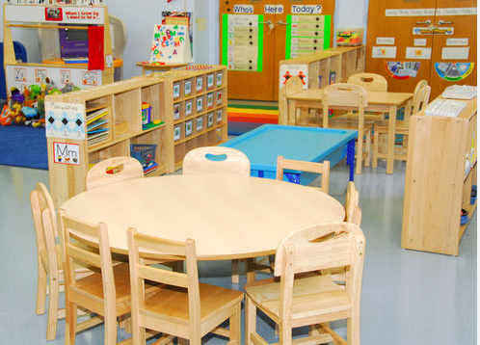
Missing a substantial amount of school in pre-kindergarten and kindergarten sets students up for a number of challenges. Students who are chronically absent in the early years often lack critical school readiness skills, are more likely to miss important academic milestones, and may lag behind their peers with social-emotional development.
-New Jersey Department of Education

Slide 23

Stay Connected
School Website and Social Media
-AUP (Acceptable Use Policy)
Sign up for ParentSquare: Need parent name, student name, email, and phone number
Place the monthly school calendar in a visible space within your home.
Creative Curriculum Newsletters will be sent by teachers.
Update your contact information whenever there is a change.
Join us for end of unit celebrations and activities. They will be scheduled

Slide 24

It all starts here!
Your child and family start with us on September 5, 2025. We can’t wait to welcome you!

